Slide 1
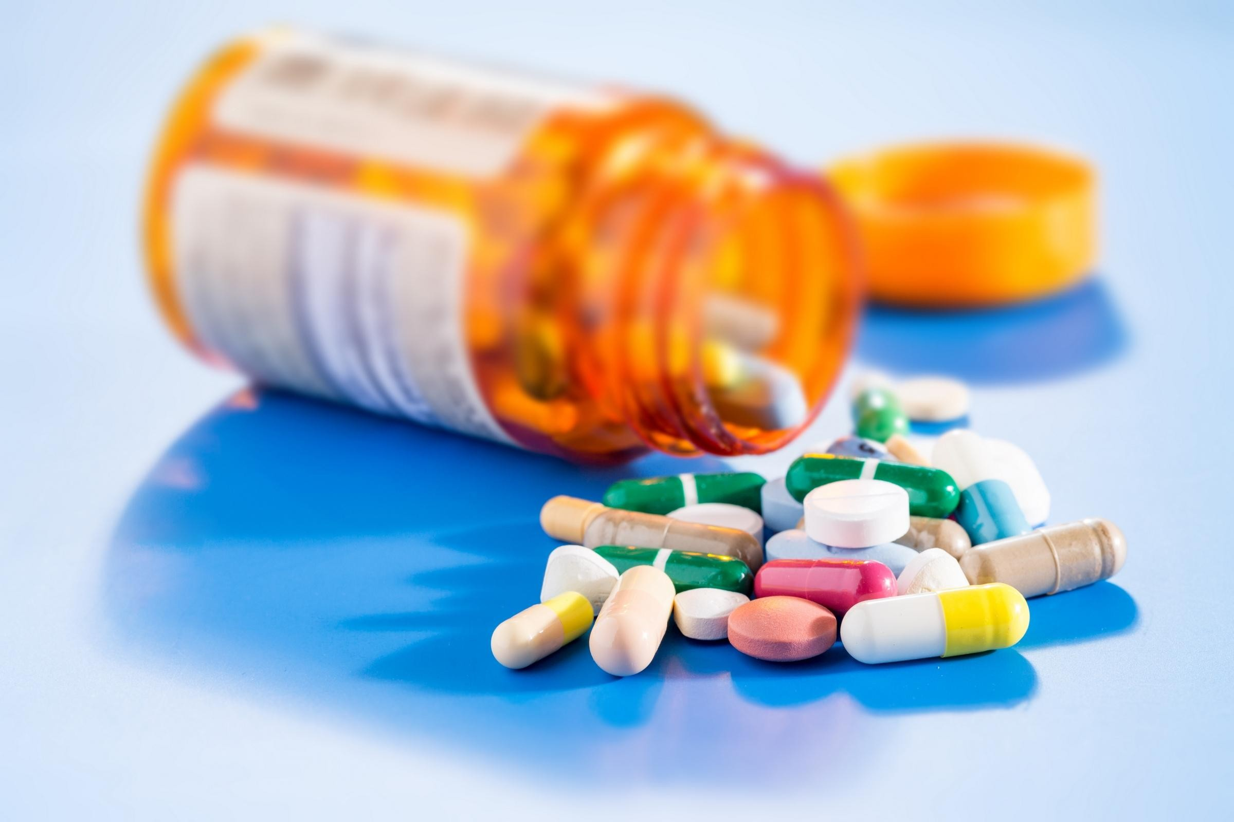

Optum Stratethon Season 4
Team ByteCoders – Aman kumar, Mayank Chittora, Shivam Singhal
SRMIST KTR

Slide 2




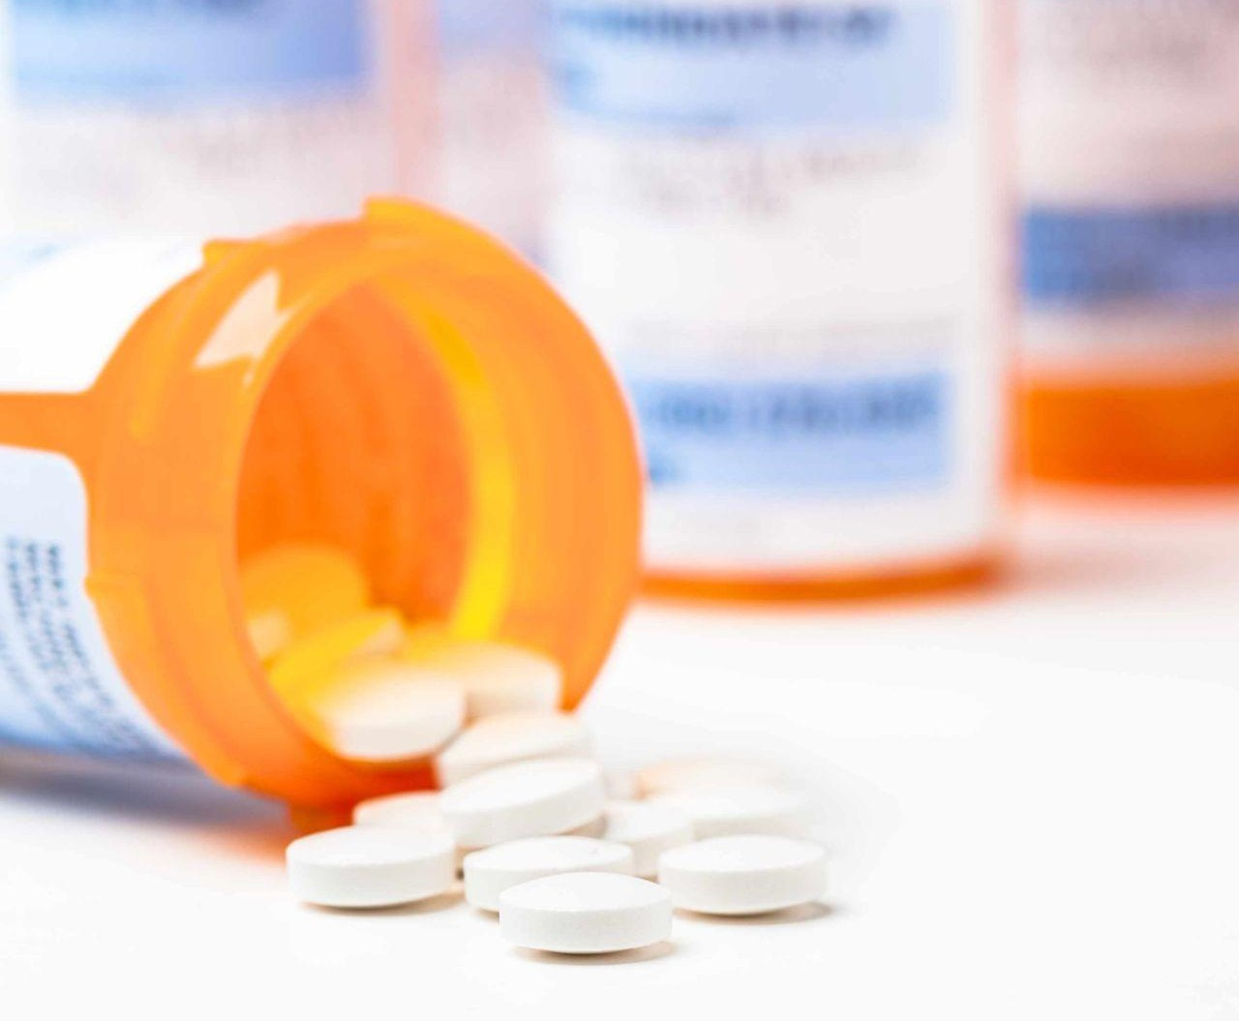


NON ADHERENCE MEDICATION
USE CASES
PROBLEM STATEMENT
SOLUTION
IMPACT
When a patient is unable to take their medication, the effects can be devastating.
Our country is facing a healthcare affordability crisis that places the burden of high out-of-pocket costs on seriously ill patients, impeding adherence to their prescribed treatments. Patients often resort to cost-saving measures—such as cutting pills or delaying their next prescription reﬁll—just to make ends meet.

Slide 3





does the work for you!!
MedCall
USE CASES
SOLUTION
PROBLEM STATEMENT
IMPACT
A pre-schedule call set at your comfort to remind you of your meds.
A ﬁve min delayed whatsapp message reminder , to keep a check on the initial call
Booking appointments from the comfort of your couch.

Slide 4





1
2
USE CASES
PROBLEM STATEMENT
SOLUTION
IMPACT
Dr. SMITH
LISA
Head Medical practitioner at a multi-speciality hospital.
Lisa is a 70 year old woman.
Measures the probability of patient being non-adherent to medication and listing out reasons for it.
Lisa can take self-care by setting reminder for hers meds and its renewal in real time.

Slide 5



1
USE CASES
PROBLEM STATEMENT
SOLUTION
IMPACT
Dr. Smith along with bytecoders have devised a python machine learning model which on providing relevant patient information like race,gender,age etc can predict whether a patient can be non adherent in coming future
Along with this a detailed analysis of the patient mass is also performed that gives an overview for the base of the above prediction

Slide 6
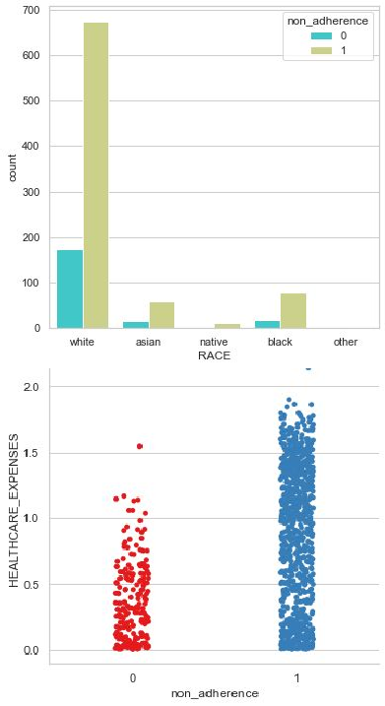
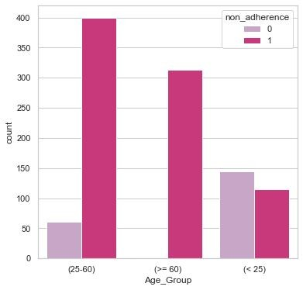
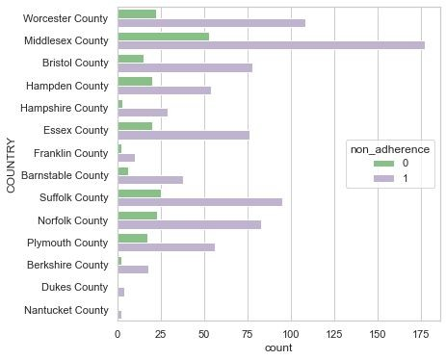
DETAILED ANALYSIS OF NON-ADHERENCE
USE CASES
PROBLEM STATEMENT
SOLUTION
IMPACT

Slide 7


2
PROBLEM STATEMENT
SOLUTION
IMPACT
USE CASES
Lisa’s medication is in constant watch as she uses medcall the online reminder, tracker for her meds and easy appointment scheduling, all of this integrated in a single platform.
Medcall aims at reduction of non-adherence in medication by simple ways like scheduling a reminder call and a whatsapp message for further check.

Slide 8




IMPACT & UNIQUE SELLING POINT (USP)
250,000
80% 30%
DEATHS
Is it OK to miss a dose?
Adherence to your medications (that is, taking them exactly as prescribed by your doctor) is very important. Here's why.
When you take your medication on a regular basis, your body reaches what is known as “steady state” .
You can tie your drug doses with a daily call reminders like breakfast time, after a shower, or when you get ready for bed.
Keep yourself updated with medications prescription reﬁll date and time.
MEDCALL is a unique service that doesn't just remind you on call for taking medication but also schedules appointments as well as reminds you via WhatsApp.
USE CASES
STATEMENT
PROBLEM
IMPACT
ABOUT

Slide 9


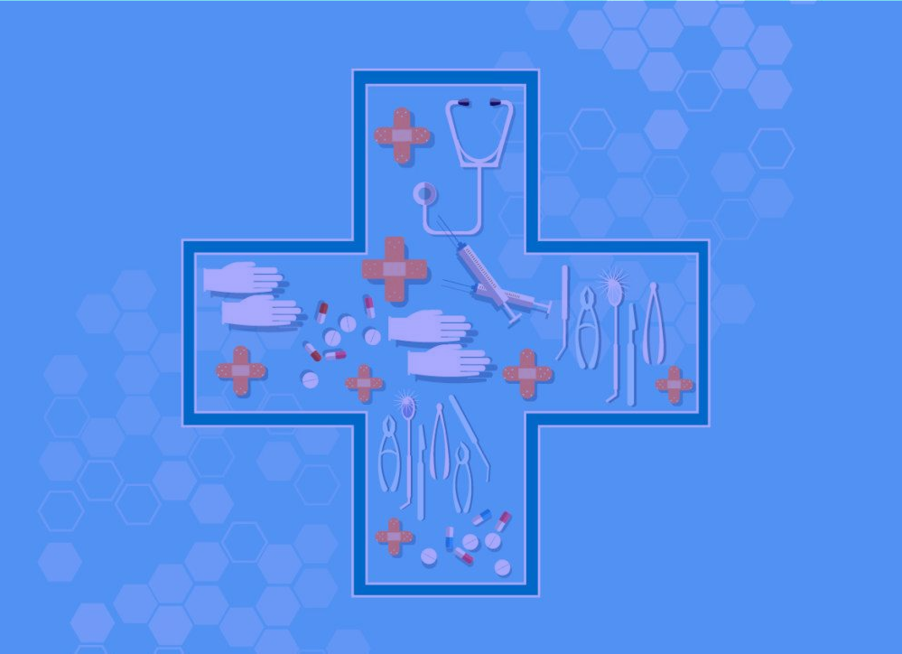


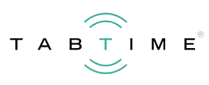


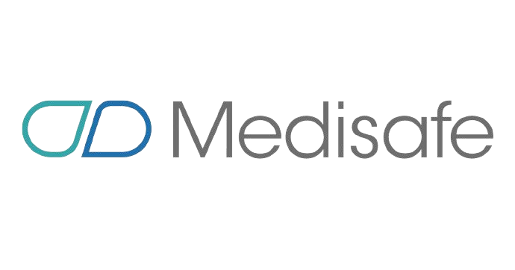
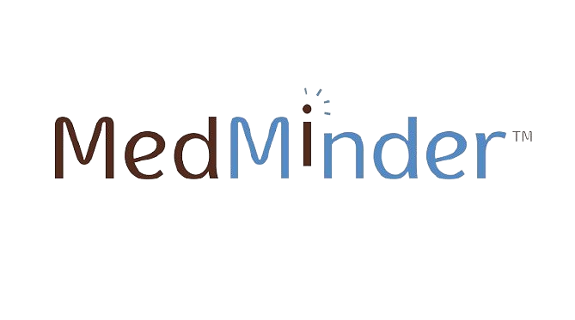



Comparative Metrics
250,000
80% 30%
DEATHS
No appointments booking system
Appointments booking system
Medicine Reminder
USE CASES
STATEMENT
PROBLEM
IMPACT
ABOUT
No Medicine Reminder

Slide 10
IMPORTANT LINKS
250,000
80% 30%
DEATHS
Project link : https://med-call.herokuapp.com/
Github :
https://github.com/Mayank18-dotcom/Bytecoders-Stratethon
EDA Automator : https://share.streamlit.io/iamamankumar22/eda-automator/m ain/app.py
USE CASES
STATEMENT
PROBLEM
IMPACT
ABOUT

Slide 11

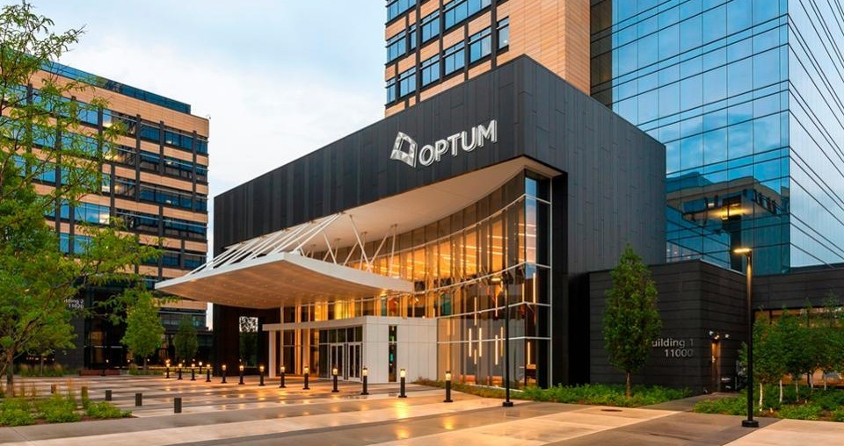
THANK YOU
Aman kumar
Mayank Chittora Shivam Singhal

